Slide 1


Slide 2


Chaorai Prompt
Software team project
By team Untitled

Slide 3



Software Idea
The number of fresh markets is decreasing. On the other hand, the number of healthy food consumers is increasing.
Farmer can't find the market to sell their products.
Some middlemen exploit farmers.

Slide 4



Software Concept
Chaorai Prompt is a Mobile Web Application that maps product sellers to the buyers like Amazon, Shopee but Farmer Prompt focuses on agricultural products.

Slide 5




Product Vision
For Thai farmers WHO want to sell their products on the fair price THE ChaoraiPrompt is an E-Commerce mobile web application THAT aims to be a new open market of agricultural products UNLIKE other e-commerce because we focus on agricultural products.

Slide 6
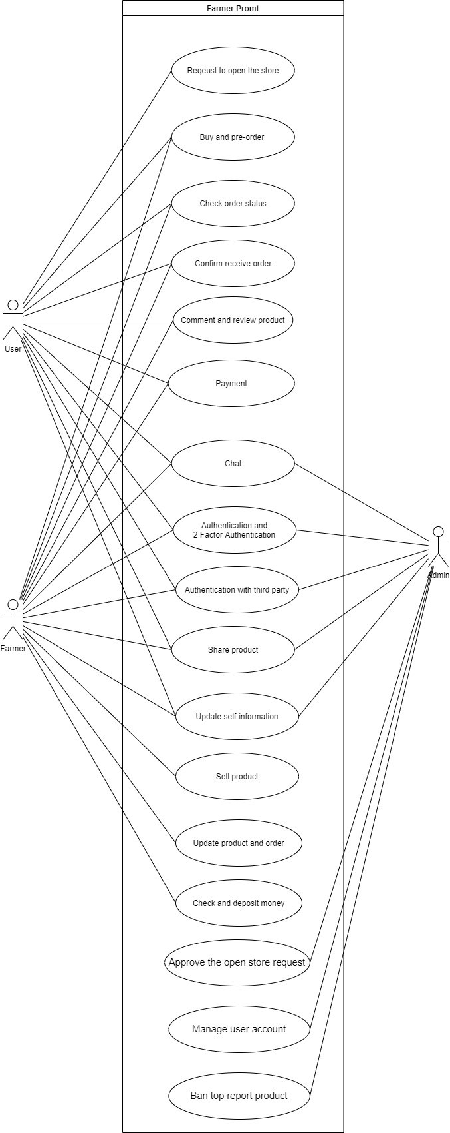
Use case

Slide 7




Software Feature
Users can buy the product from the seller, and they can request permission to sell the product.

Slide 8
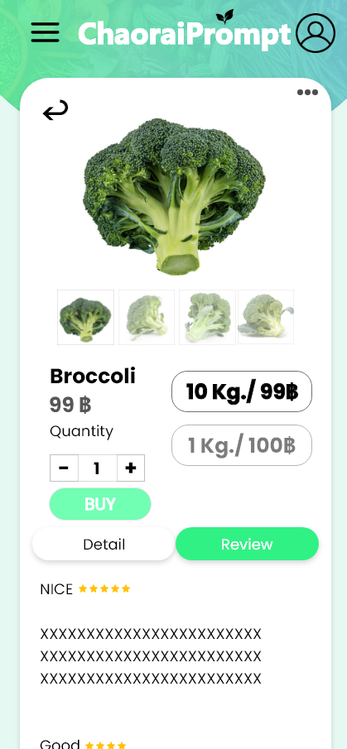
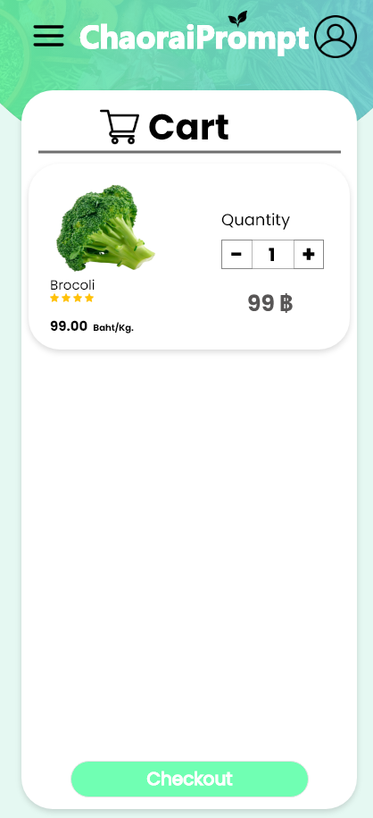
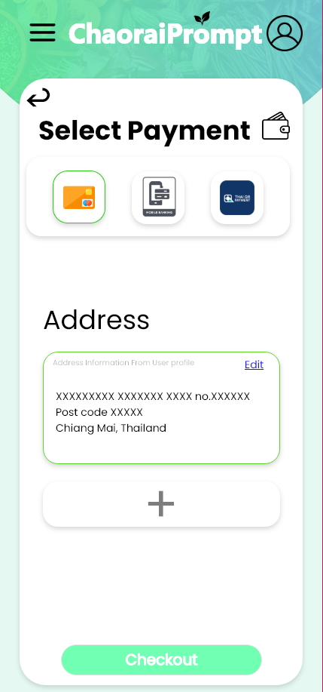
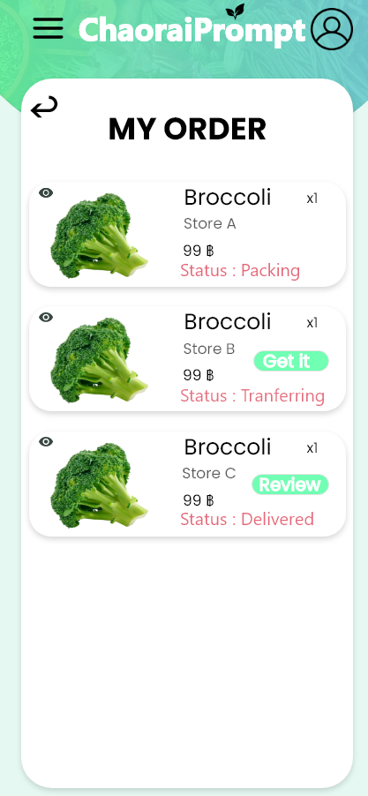
Software Feature

Slide 9
Software Feature
Farmers extend features from user and can sell their products and withdraw the money from their accounts.

Slide 10
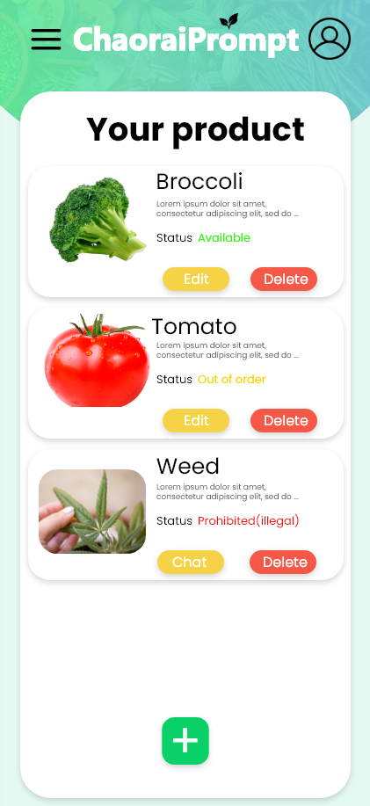
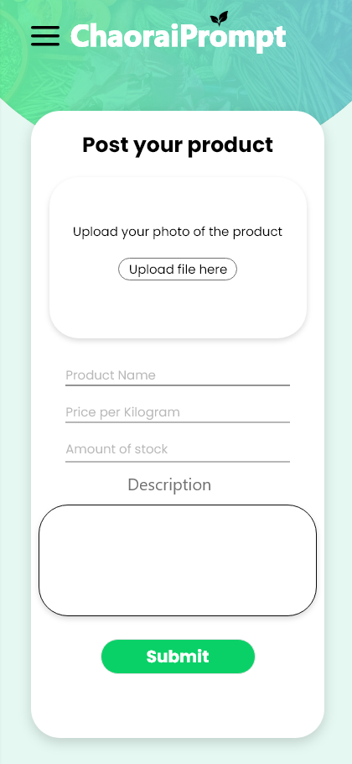
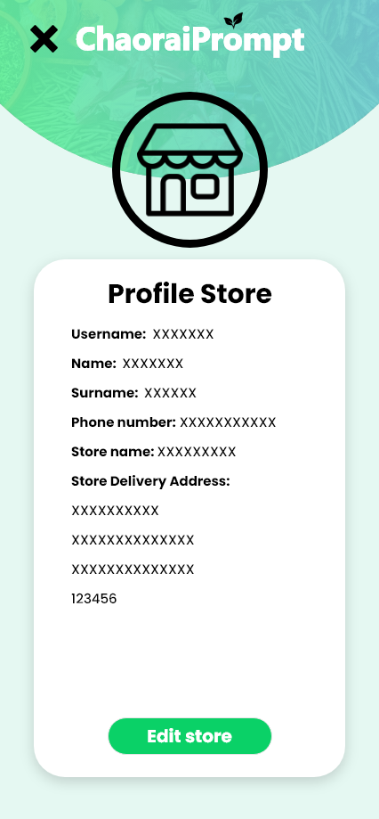
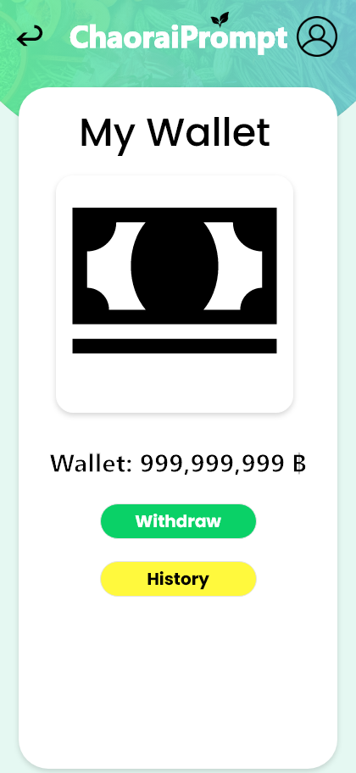
Software Feature

Slide 11



Software Feature
Admin can approve the request of users that want to become the seller and look after the products and users.

Slide 12
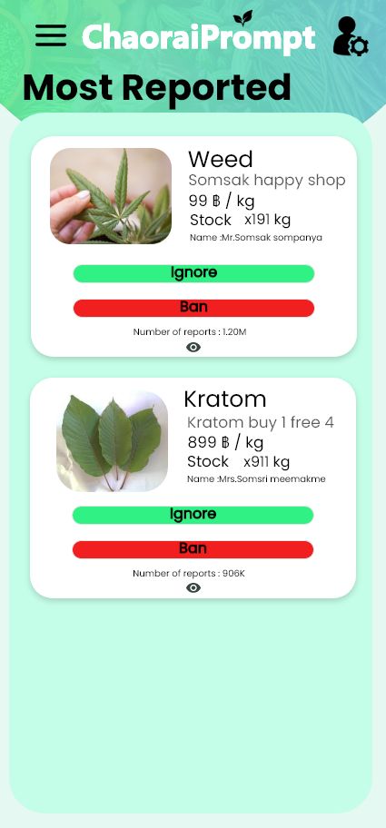
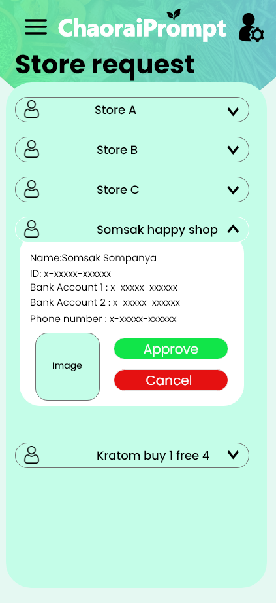
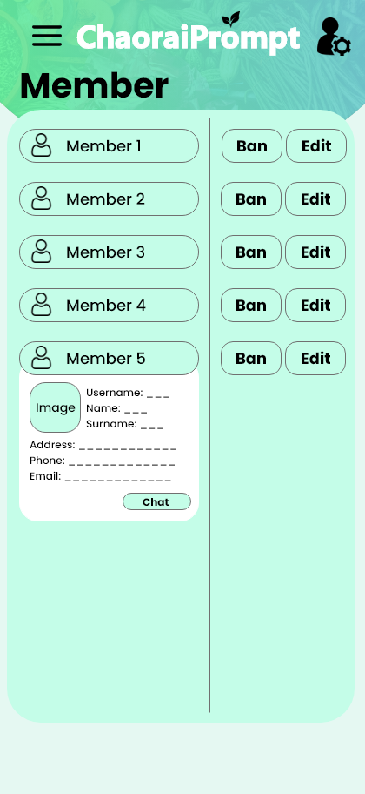
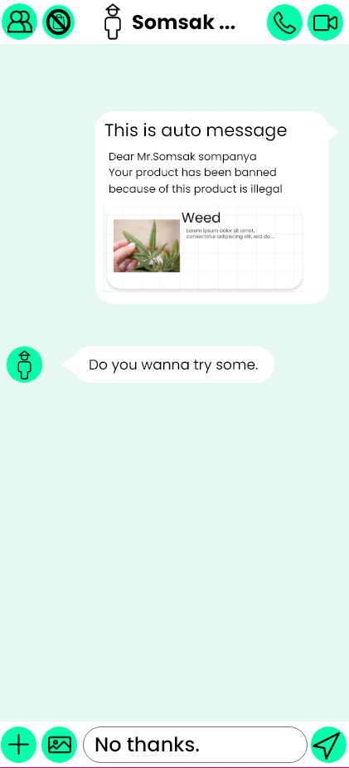
Software Feature

Slide 13
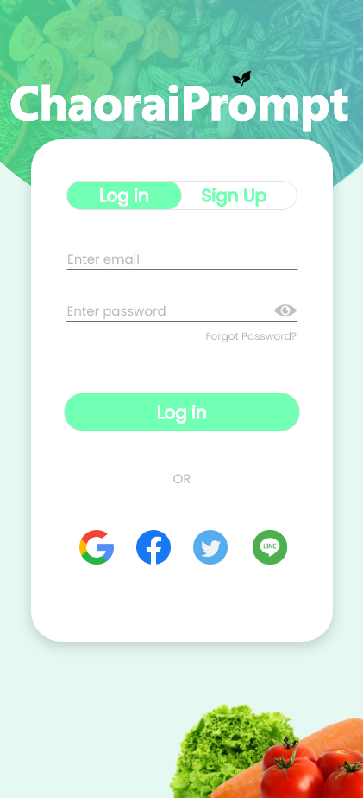

Software Feature
Third party login and register system to improve the convenient of the software.

Slide 14
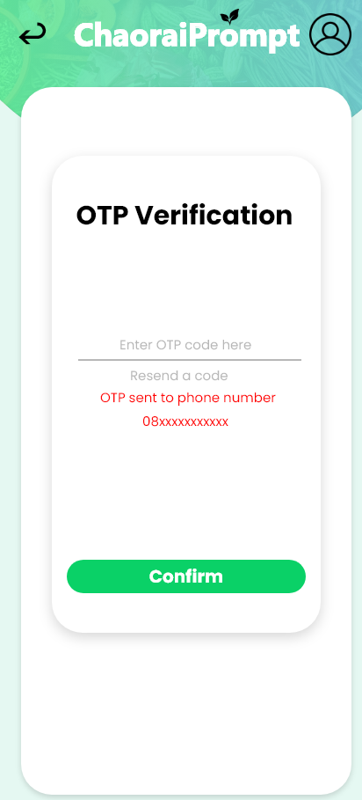

Software Feature
2 Factor authentication system to improve the system security.

Slide 15
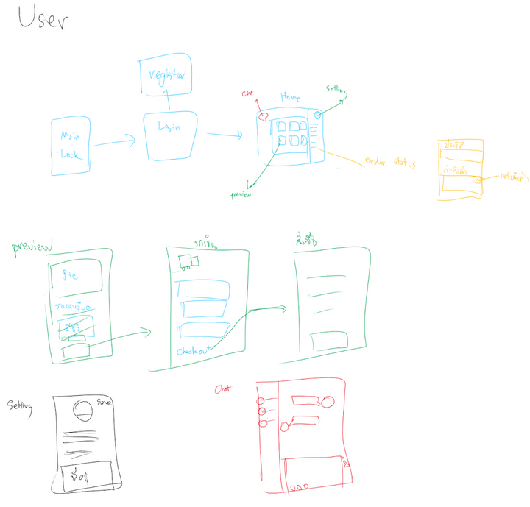
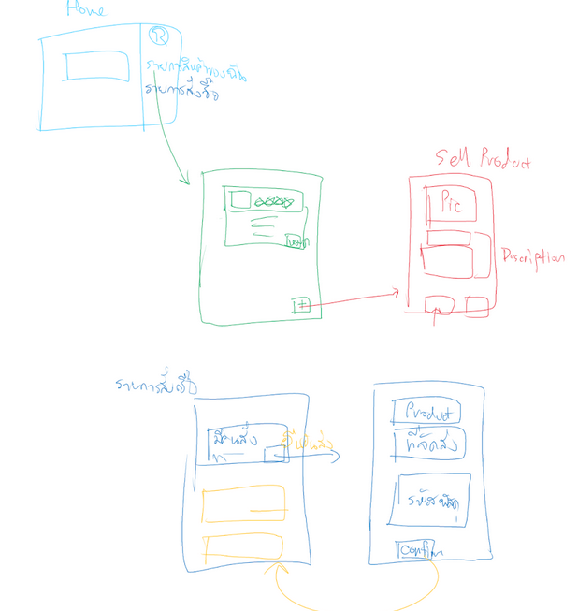
Software Design

Slide 16
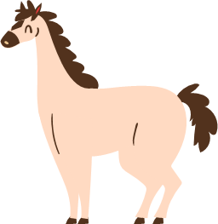


Software Prototype

Slide 17
Technology

Slide 18

Front-end

Slide 19


Back-end

Slide 20

Database

Slide 21






Tool

Slide 22


Software Progress Model
Extreme Programming
XP is suitable for our team that have 5 peoples and the requirements or feature can be changed or added any time. And our team members can work separately for 24 hours by leaving a message or today's progression in discord and other members can continuously work on it.

Slide 23
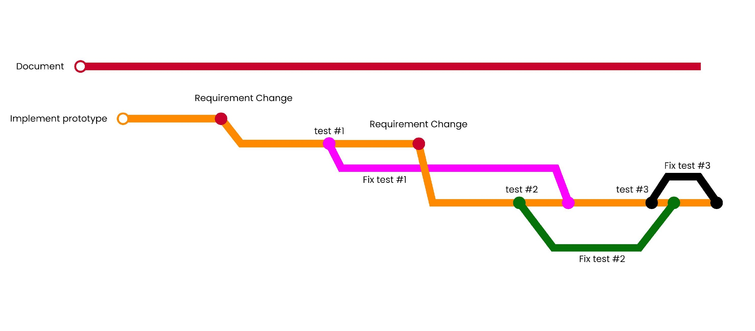
Project Timeline

Slide 24
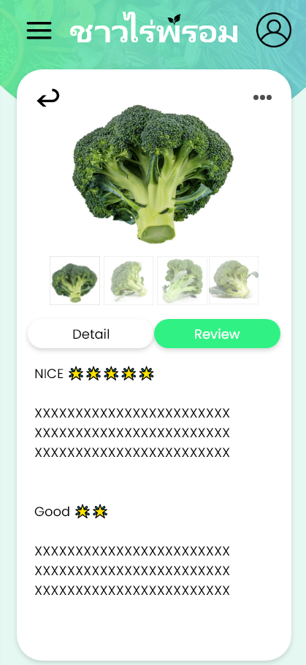
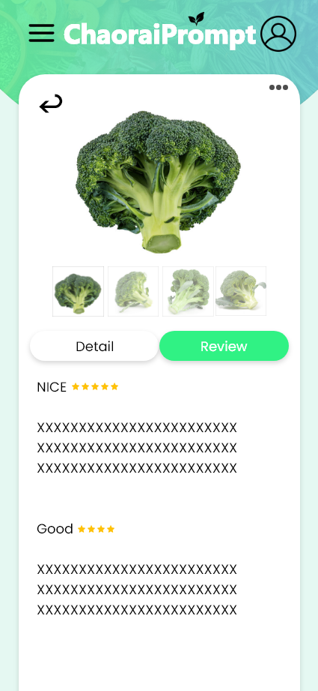
Usability Testing
Test all features of the software start with user, farmer and admin features
Techniques: Think Aloud
Failure point: Some word are used incorrectly, Color Palette of UI and icon of user

Slide 25

Team member
Kan Katpark (Project manager , Software Architecture & Analyst)
Jakkaphat Polylake (Software Designer & Tester)
Dusit Chunviset (Software Designer & Tester)
Tinnapat Rattanawilaikul (Software Designer & Analyst)
Sarin Patanompee (Software Tester & Architecture)

